Slide 1
Forecasting

Slide 2
Review - Forecasting
Similar to regression, predict a target that has numeric types
However, usually involving a time dimension in the data – future values are predicted based on current and historical data
Examples:
Predict future stock prices
Predict future product sales
Like regression, this is a supervised learning task
Date | Open | High | Low | Close
1/4/2022 | 334.83 | 335.2 | 326.12 | 329.01
1/5/2022 | 325.86 | 326.07 | 315.98 | 316.38
1/6/2022 | 313.15 | 318.7 | 311.49 | 313.88
1/7/2022 | 314.15 | 316.5 | 310.09 | 314.04
1/10/2022 | 309.49 | 314.72 | 304.69 | 314.27
1/11/2022 | 313.38 | 316.61 | 309.89 | 314.98
NextClose
316.38
313.88
314.04
314.27
314.98
???

Slide 3
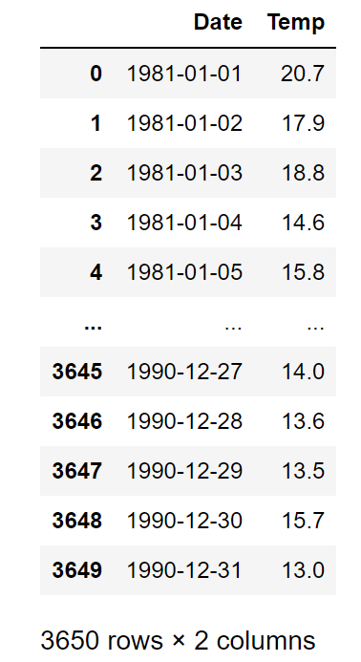
Example: Temperature Data
We will be using the daily minimum temperature data to demonstrate models in this module
The data has 3650 rows, each representing a day from 1/1/1981 until 12/31/1990
Columns are Date and Temp
We will need to transform this data to the features – target format before being able to model with it

Slide 4
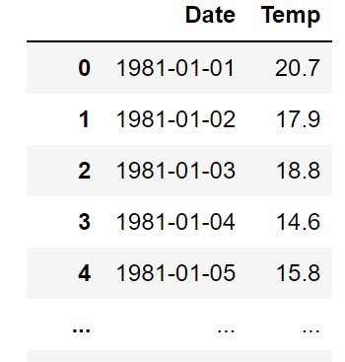
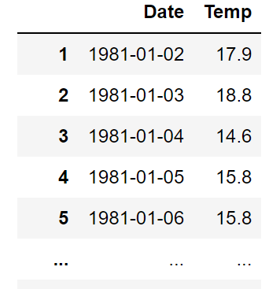
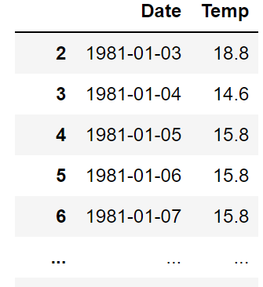
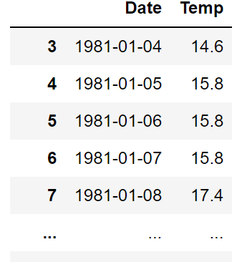
Predicting Next Day Temperature
As can be seen, the only feature in this data is Temp.
Date is a timestamp and cannot be used in models directly. It can be transformed to features such as week, month, quarter, season, holiday, etc. if needed. However, we will not do that in this example
We want the data to be in the following format
Features are temperature data until the current day. Days before that are acceptable
Target is next day temperature
Features
Target

Slide 5
Modeling
After transformation, the data can be modeled like normal regression data
However, we usually split train/test by time, not randomly. For example, the first nine years are used for training and validation, and the last year is for testing
Note: there are advance deep learning models that can automatically learn historical data without defining windows. However, we will not discuss them in this course.

Slide 6
Window Size and Performance
In general, larger window sizes mean going further into history from each current time point, and are potentially better
Depending on the nature of the data, this is not always true
The improvement can also be marginal compared to the increase in model complexity
 | Window = 5 | Window = 10
SVR | 0.657 | 0.672
Decision Tree | 0.627 | 0.611
Random Forest | 0.654 | 0.664
Neural Network | 0.650 | 0.666
Testing $R^{2}$ of models in the Daily Temperature data using different window sizes

Slide 7
Neural Network

Slide 8




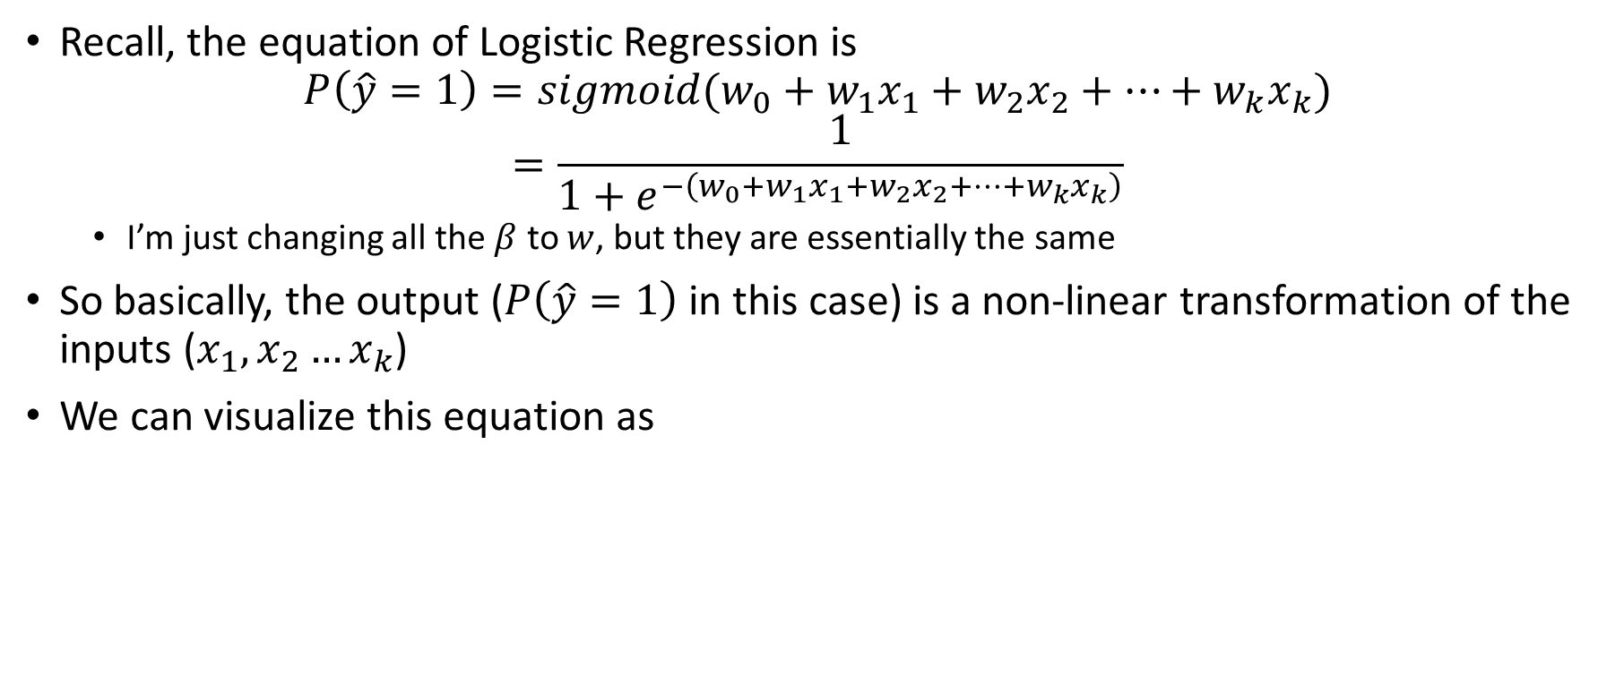






Review on Logistic Regression
Recall, the equation of Logistic Regression is
$$P\left(\hat{y}=1\right)=sigmoid(w_{0}+w_{1}x_{1}+w_{2}x_{2}+…+w_{k}x_{k})$$
$$=\frac{1}{1+e^{−\left(w_{0}+w_{1}x_{1}+w_{2}x_{2}+…+w_{k}x_{k}\right)}}$$
I’m just changing all the $β$ to $w$, but they are essentially the same
So basically, the output ($P\left(\hat{y}=1\right)$ in this case) is a non-linear transformation of the inputs ($x_{1},x_{2}…x_{k}$)
We can visualize this equation as
$$P$$
$$w_{0}$$
$$w_{1}$$
$$w_{2}$$
$$w_{3}$$
$$w_{k}$$
1
$$x_{1}$$
$$x_{2}$$
$$x_{3}$$
$$x_{k}$$

Slide 9



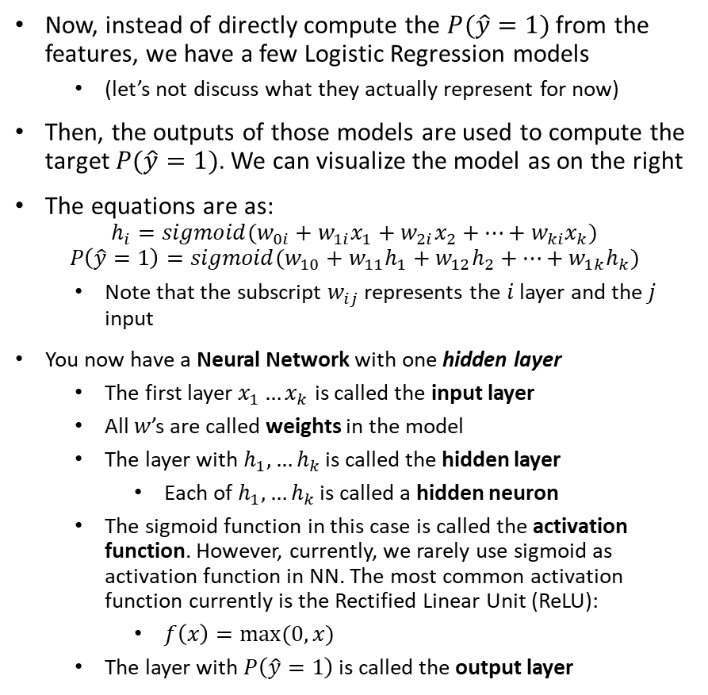





Adding a Layer
Now, instead of directly compute the $P(\hat{y}=1)$ from the features, we have a few Logistic Regression models
(let’s not discuss what they actually represent for now)
Then, the outputs of those models are used to compute the target $P(\hat{y}=1)$. We can visualize the model as on the right
The equations are as:
$$h_{i}=sigmoid(w_{0i}+w_{1i}x_{1}+w_{2i}x_{2}+…+w_{ki}x_{k})$$
$$P\left(\hat{y}=1\right)=sigmoid(w_{10}+w_{11}h_{1}+w_{12}h_{2}+…+w_{1k}h_{k})$$
Note that the subscript $w_{ij}$ represents the $i$ layer and the $j$ input
You now have a Neural Network with one hidden layer
The first layer $x_{1}…x_{k}$ is called the input layer
All $w$’s are called weights in the model
The layer with $h_{1},…h_{k}$ is called the hidden layer
Each of $h_{1},…h_{k}$ is called a hidden neuron
The sigmoid function in this case is called the activation function. However, currently, we rarely use sigmoid as activation function in NN. The most common activation function currently is the Rectified Linear Unit (ReLU):
$f\left(x\right)=max⁡(0,x)$
The layer with $P\left(\hat{y}=1\right)$ is called the output layer
$$P$$
1
$$h_{1}$$
$$h_{2}$$
$$h_{k}$$
1
$$x_{1}$$
$$x_{2}$$
$$x_{3}$$
$$x_{k}$$

Slide 10
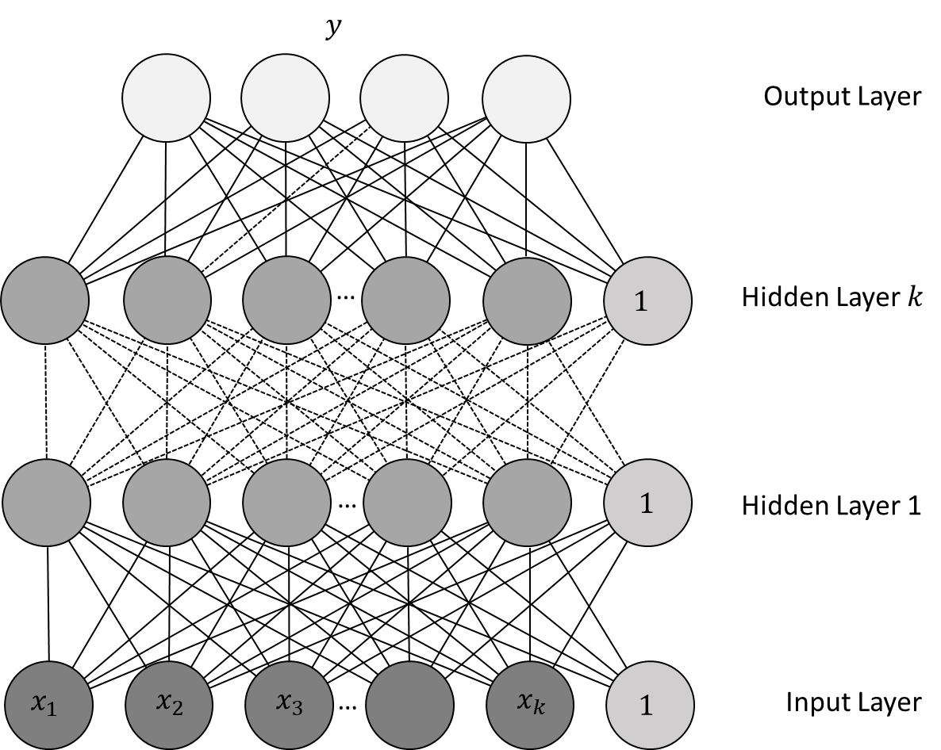
Neural Network
From the previous example, we can generalize a Neural Network as a multi-layer model
Each layer is computed as a non-linear transformation of the previous layer
The number of hidden layers and the number of hidden neurons per layer are hyper-parameters to be finetuned
The model in the output layer depends on the task, most commonly
Logistic regression for Binary Classification
SoftMax regression for Multi-label Classification
Linear regression for regression
A NN is also called a Multi-Layer Perceptron (MLP)
Similar to other machine learning models, MLP is trained to minimize a training objective, and would need regularization to prevents the weights from getting extreme values

Slide 11
Finetuning a NN/MLP
As you can see, NN models have two important hyper-parameters
Number of hidden layers
Number of neurons in each layers
This makes NNs a bit trickier to train – there are two many possibilities for these hyperparameters
Some of my personal experiences with DNN:
Deeper models are more prone to overfitting, but also are more difficult to train
Wider models (i.e. more neurons per layers) are easier to train but also easier to overfit the data
In general, we usually train networks with three to five hidden layers
The numbers of neurons in each layer are not necessarily equal to each other, however I usually use equal numbers, and also equal to a factor of number of input features
For example, if we have 5 input features, then each layer may have 5, 10, 15, or 20 neurons
In sklearn, NNs are quite a bit slower to train than other models. So, you should limit the number of architectures to try, especially when the data is large
In sklearn, we use MLPClassifier for classification, and MLPRegressor for regression

Slide 12
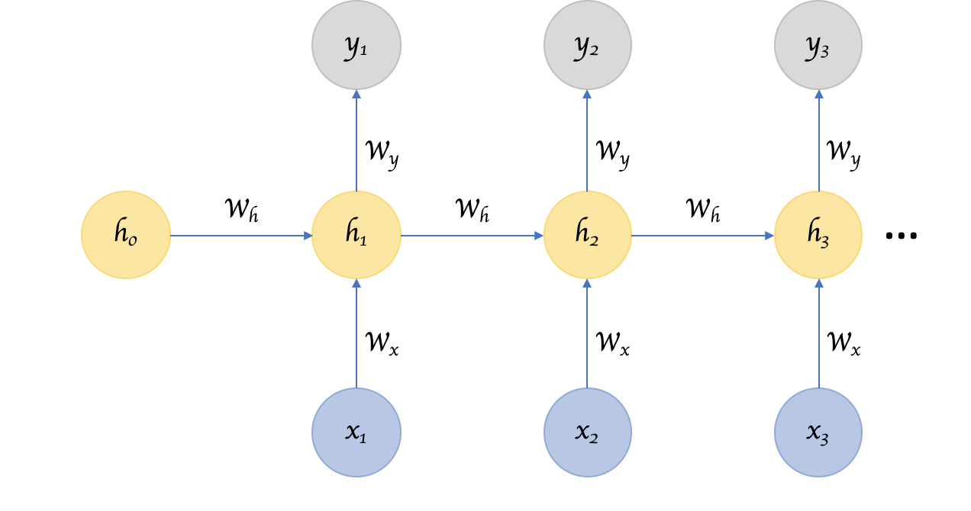
Recurrent Neural Network
The most effective way to model sequential data is to use Recurrent Neural Network (RNN). This is a special type of neural networks that are designed to handle temporal correlations in sequential data
The idea of RNN is that, at each time point, we calculate the current hidden state using the current input and the previous hidden state
In this module, we use Gated Recurrent Unit (GRU) which is a type of RNN. This can be implemented in tensorflow
$x_{t}$: Input at each time step
$h_{t}$: Hidden state at each time step
$y_{t}$: Output at each time step

Slide 13
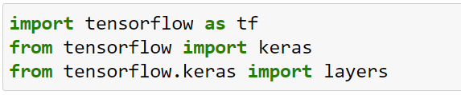
Tensorflow
For advance deep learning models like RNNs, we need to use the Tensorflow library.
The model building step is also a bit more complicated
First, we need to import all the necessary modules

Slide 14
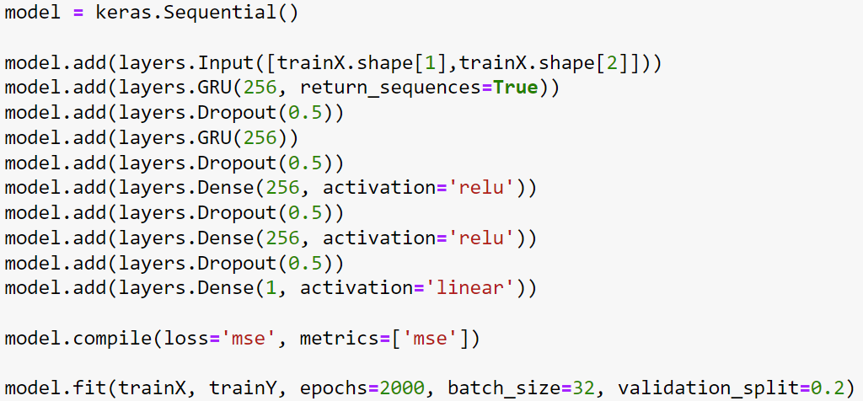
Building a deep network with tensorflow
Always start with an Input layer.
For sequential data, the input is always like this (if your training feature is trainX)
Add a RNN layer type GRU. 256 is the size and can be changed. If you want to use multiple RNN layers, intermediate layers must have return_sequences=True
Create a new model
Add layers to the network
Dropout regularization for each layer. Value is between 0 and 1, higher is more strictly regularizing
Last RNN layer only has size
These are regular MLP layers, size is changeable
Output layer. This is for regression task.
Call function to train the model

